Slide 1
Czech Real Estate Analysis
Author: Matěj Foukal
Course: Seminar on Data Mining (NAIL121)

Slide 2
Objectives

Slide 3
Data Sources

Slide 4
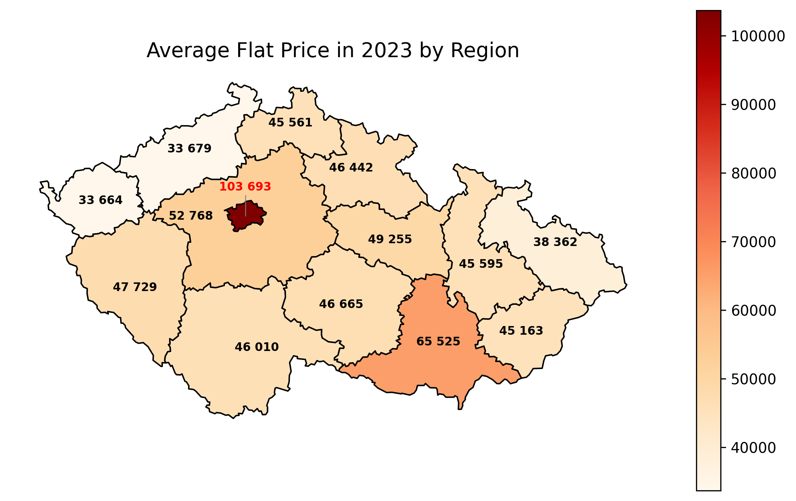
Q1: Which regions had the highest average flat prices in 2023?

Slide 5
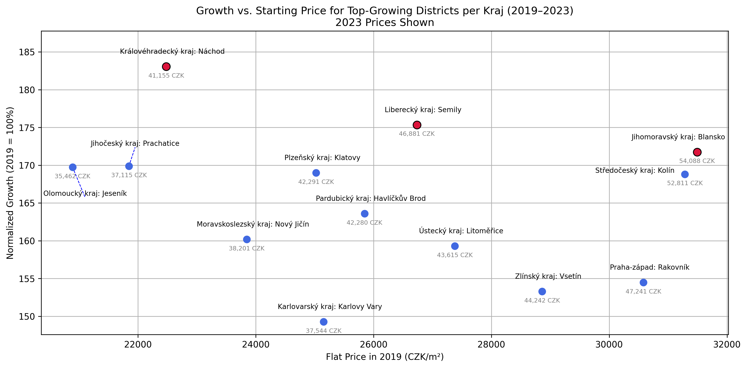
Q1: Which regions had the highest average flat prices in 2023?

Slide 6
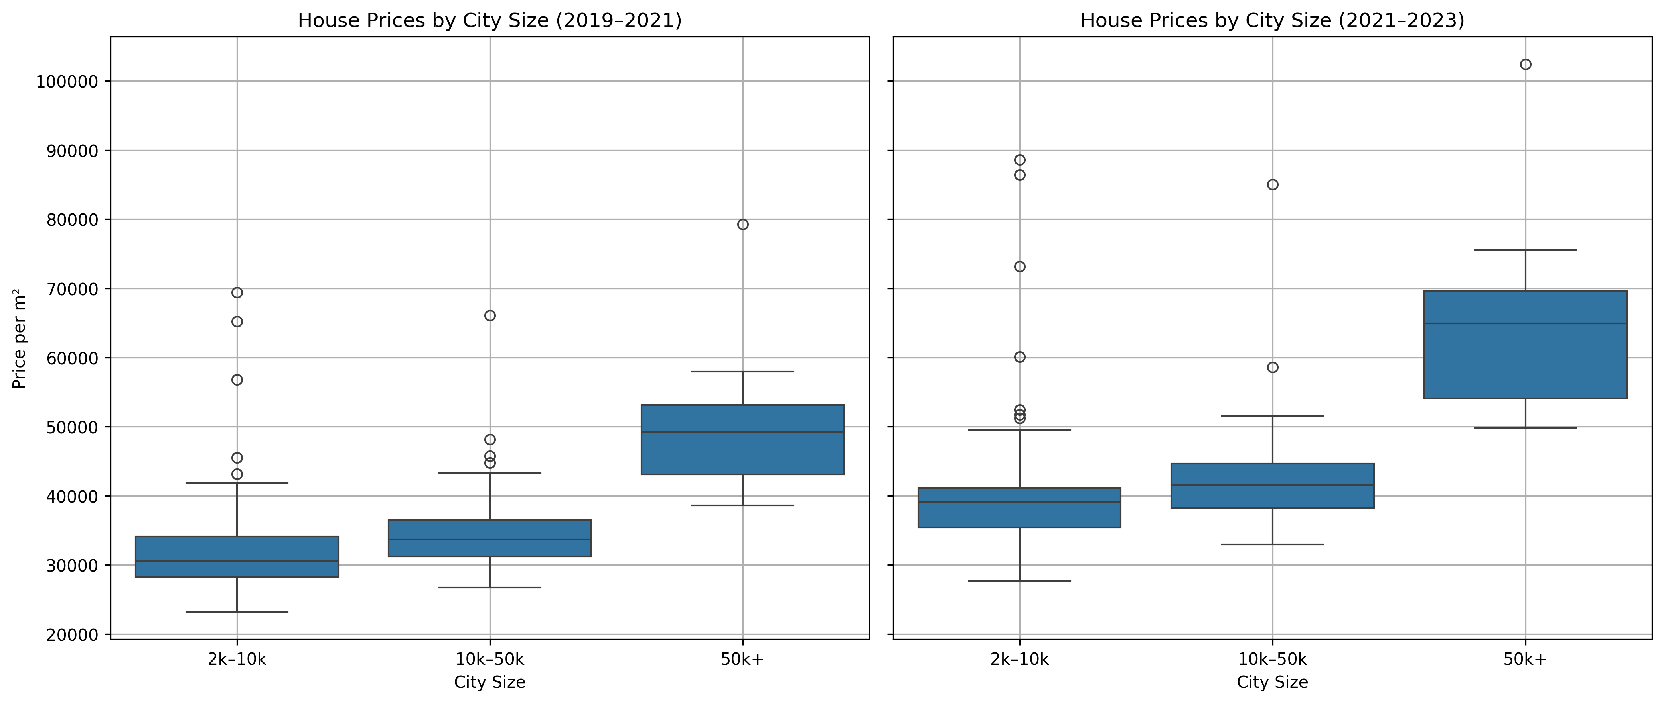
Q1: Which regions had the highest average flat prices in 2023?

Slide 7
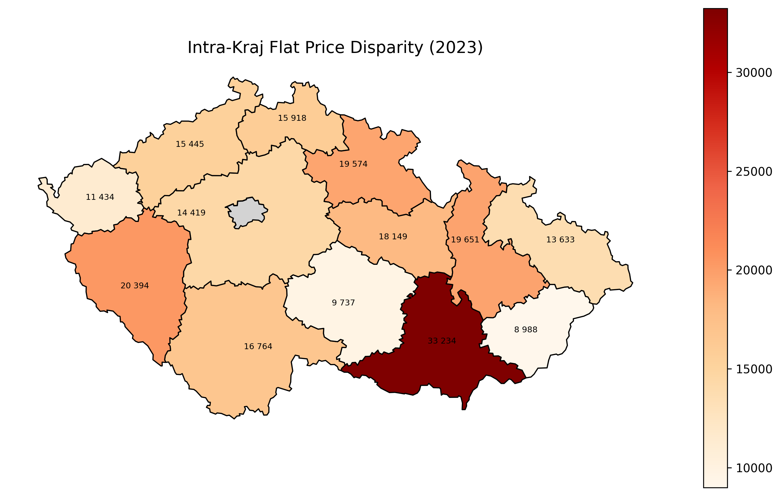
Q1: Which regions had the highest average flat prices in 2023?

Slide 8
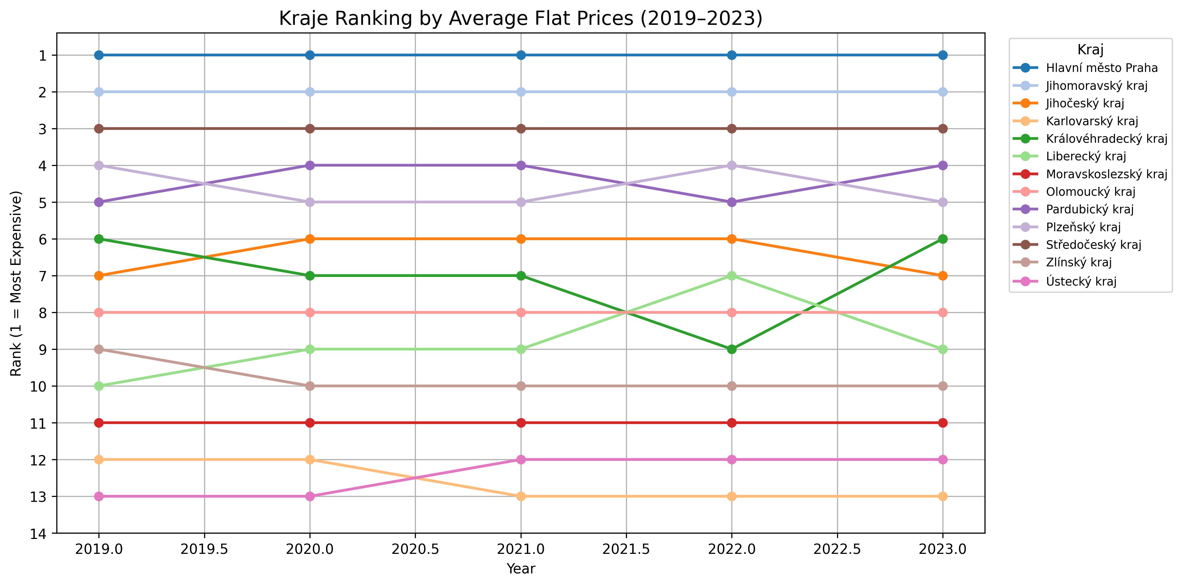
Q1: Which regions had the highest average flat prices in 2023?

Slide 9
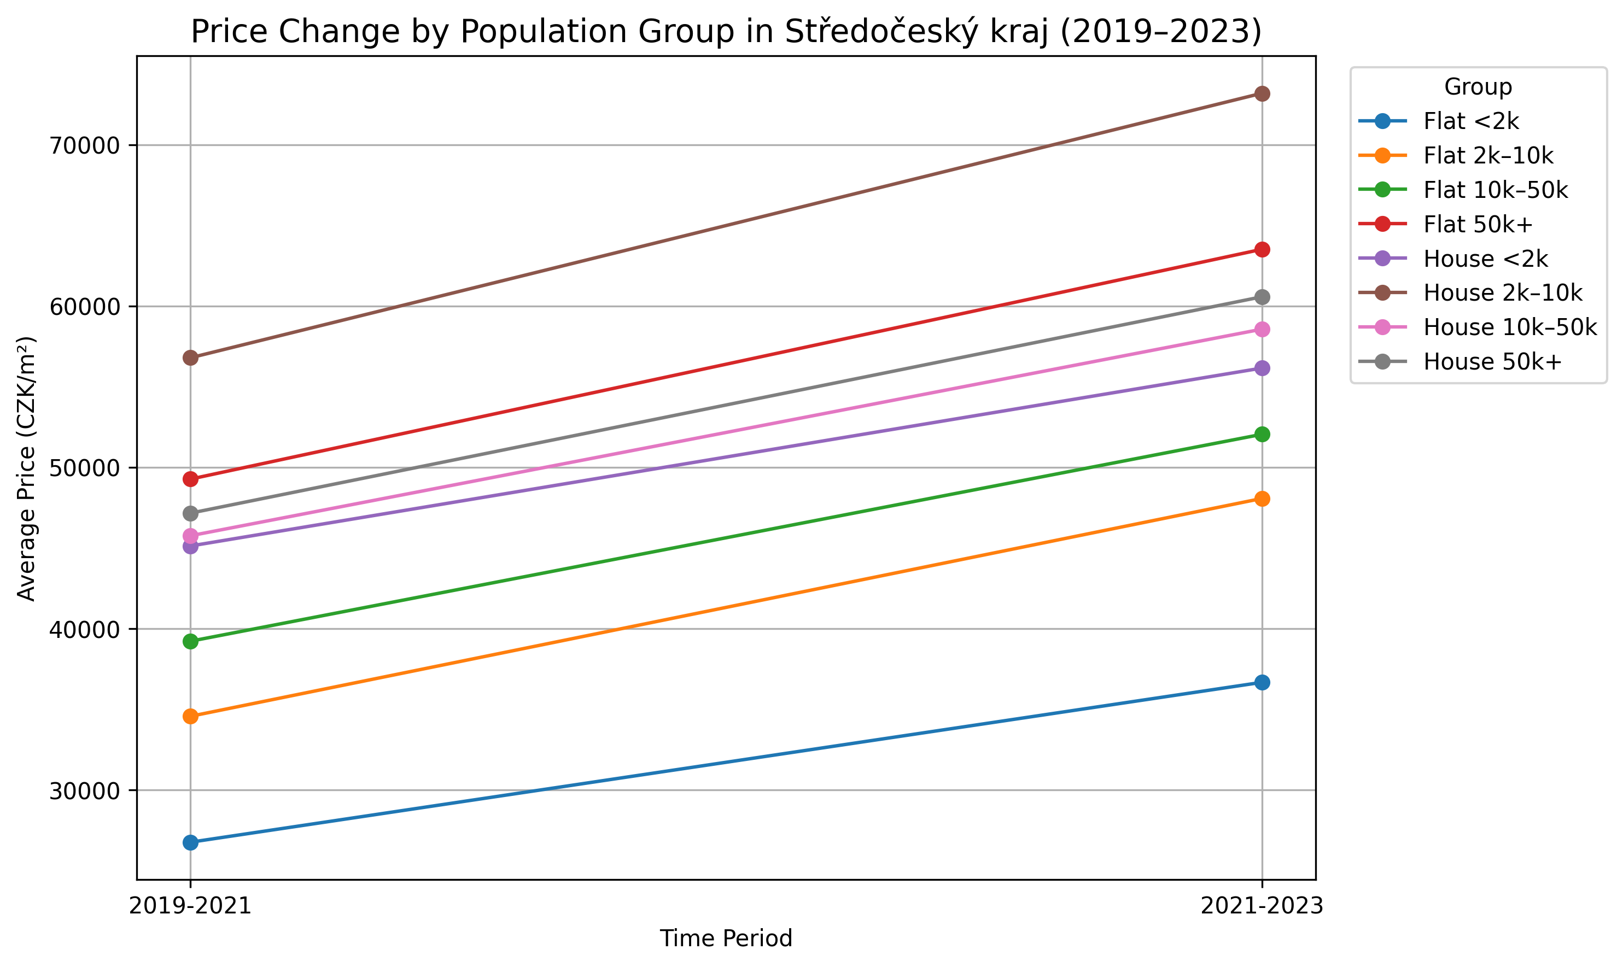
Q1: Which regions had the highest average flat prices in 2023?

Slide 10
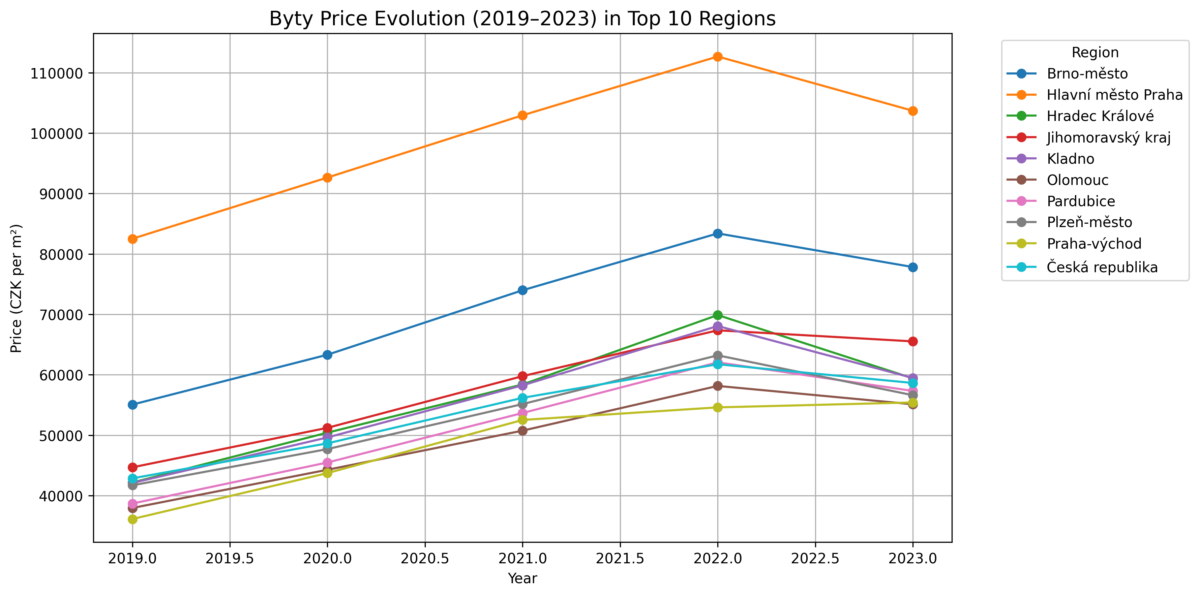
Q1: Which regions had the highest average flat prices in 2023?

Slide 11
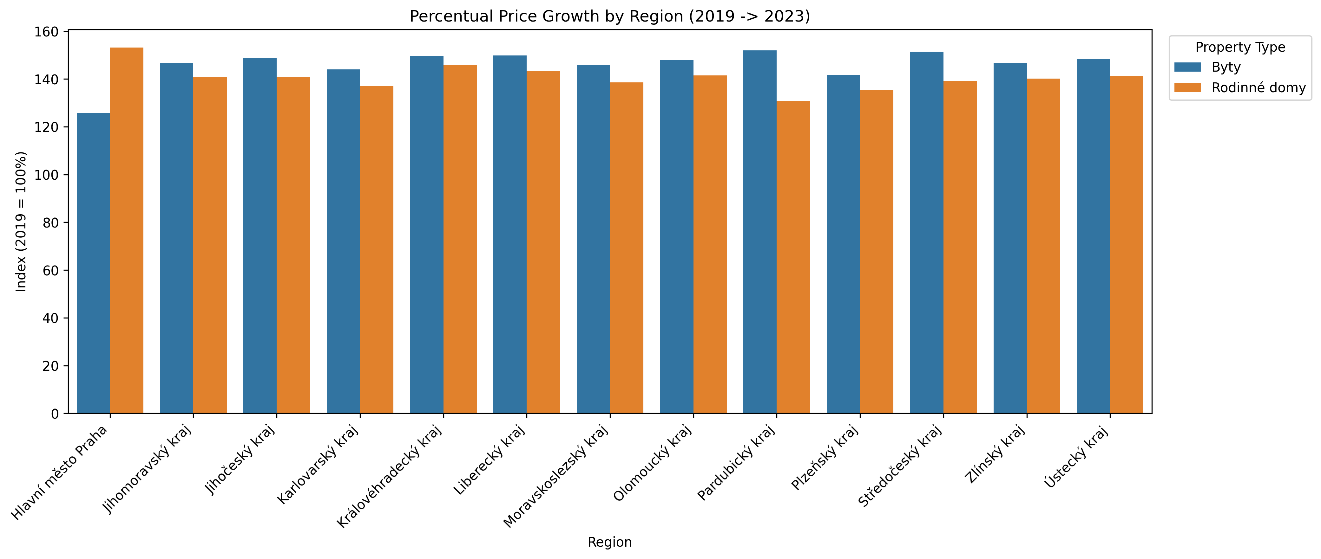
Q1: Which regions had the highest average flat prices in 2023?

Slide 12
Findings

Slide 13

Source code

